Slide 1


Capstone Project PHIT Program
Group 4
Final Report prepared by:
Quintin Davis
Emeka Okafor
Jeanene Thomas
Hailegiorgis Kebede
Anil Mangla
Tolulope Oshuntoye
Rosheen Simpson
Yousaf Chaudry
Mentor: Olalekan Ismail Abdulazeez

Slide 2
Introduction
Background
Population health is defined as "the health outcomes of a group of individuals, including the distribution of such outcomes within the group.” ¹
Requires focusing on all aspects that constitute health and well-being².
Socioeconomic disparities play a critical role in determining the differences in level of health and lifespan.
Disproportionately affect some individuals and groups of people, such as those with low educational attainment.
Respiratory illnesses are diseases that affect lungs and/or other parts of the respiratory system
Can be caused by bacteria, viruses, lifestyle choices (such as smoking), and other factors
One example is COPD (chronic pulmonary obstructive disorder), which CDC estimates place as a leading national cause of death with an associated healthcare cost of nearly $50 billion each year
COVID-19 is another example of a respiratory illness, becoming a worldwide pandemic that was most difficult for those with compromised respiratory systems

Slide 3
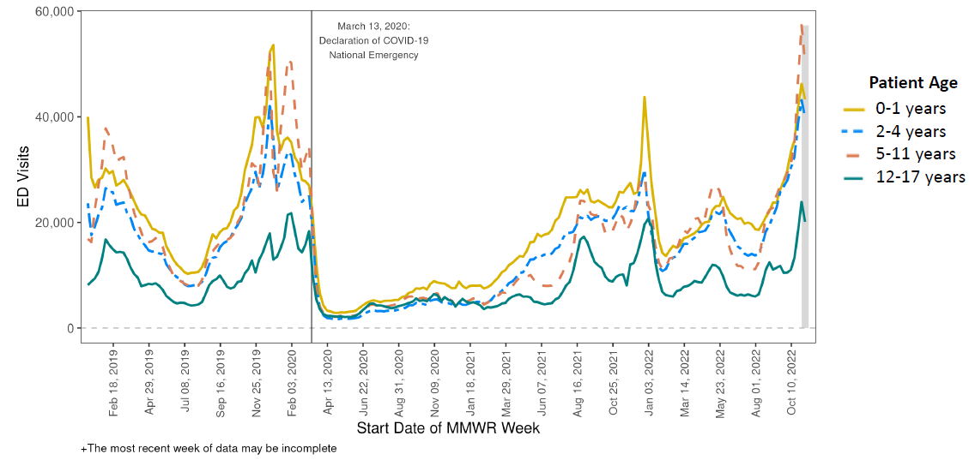
Weekly U.S. Emergency Department (ED) Visits in Patients with Acute Respiratory Illness*, Ages 0-1, 2-4, 5-11, and 12-17 Years, Dec 30, 2018, to Nov 12, 2022, National Syndromic Surveillance Program

Slide 4
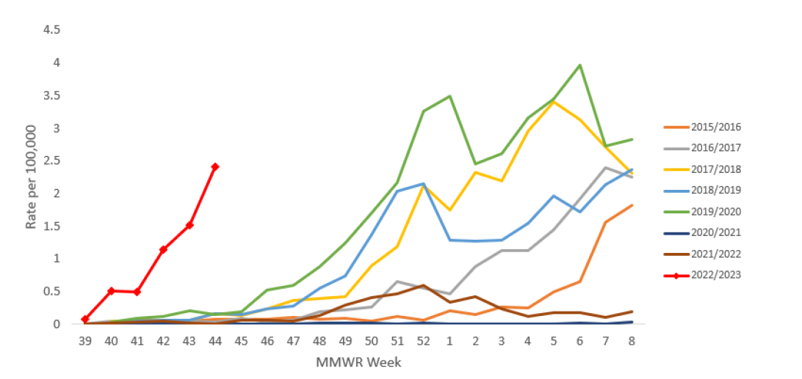
Weekly Rates of Influenza-Associated Hospitalization in Children <18 years by surveillance season - FluSurv-NET, 2014-2022

Slide 5
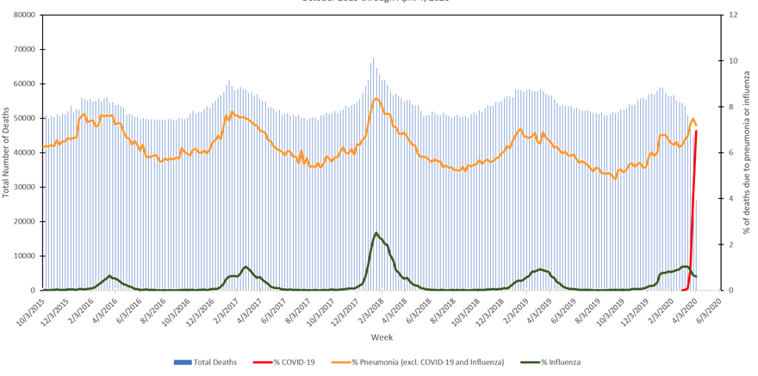
Total Deaths and Percentage of Deaths due to COVID-18, Pneumonia or Influenza Oct 2015 to April 2020

Slide 6
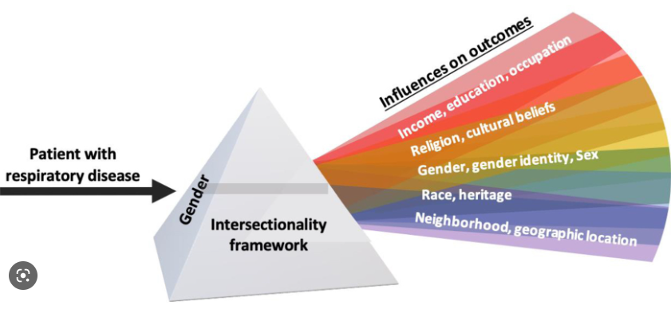
The Impact of Social Determinants of Health (SDoH)on Respiratory Diseases

Slide 7
Research Question
In the context of respiratory illness, how can we understand the effects of cost, insurer, and severity of illness, when analyzed relative to a patient’s race, age, and geographic location?
Notes:
11/16/22: previous text = The effects of cost, insurer, and severity of illness in terms of a patient’s race, age, county and effect on the insurer, –Yousaf

Slide 8
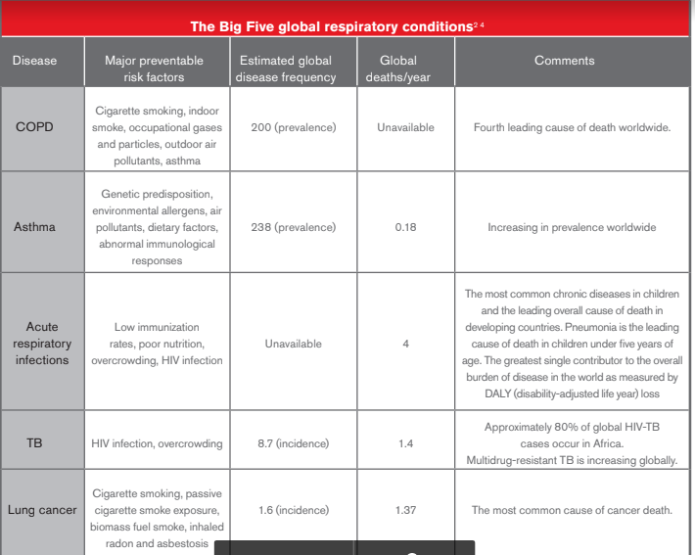

Slide 9
Literature Review
(Inpatient-Data Dictionary, 2021)– Inpatient-Data Dictionary; Center for Health Statistics
Indicators identify whether facilities require to submit diagnosis Present on Admission (P.O.A) codes.
Facility indicators provide data users with information on the type of facility providing the inpatient service.
(DIXON, 1985)
To evaluate one aspect of the respiratory tract infections in the United States, national survey data were used to estimate direct and indirect economic cost. Overall upper and lower respiratory tract infections are to be responsible for approximately $15 billion in direct treatment cost.

Slide 10
Literature Review (cont.)
(J.Carl Holowaty M.D.)
Trends in respiratory Diseases; i.e. COPD, asthma, acute respiratory infections, TB, and lung cancer
Millions of people are Burdened with chronic respiratory conditions. 4 million die prematurely from chronic diseases each year.

Slide 11
Project Goals
To determine if the Severity of respiratory illnesses triggers a higher risk for Mortality
To determine if Age and Gender are determinant factors in survival of respiratory illness
To find ways of improving respiratory patients’ healthcare outcomes
To help eliminate barriers to quality care and increase health equity

Slide 12
Methods
Data Source
The source of the data is the Texas Health Care Information Collection(THCIC), maintained by the state of Texas.
Dataset represents “health care activity in hospitals and health maintenance organizations operating in Texas” (https://dshs.texas.gov/thcic).
Includes both quantitative/numerical data (such as age/cost/length of stay) and categorical data (such as race/county/insurance).

Slide 13
Methods (cont.)
Data Cleaning/Analysis
Initially we used Tableau Prep software to clean the data of Null/empty values.
Then Tableau Desktop Professional was used to perform visualization on the data, comparing multiple variables and chart types, as well as creating maps.
Anaconda and Jupyter Notebooks were used to conduct testing on the data using Python.
PyCharm IDE was also used for revising code to conduct linear regression analysis.

Slide 14
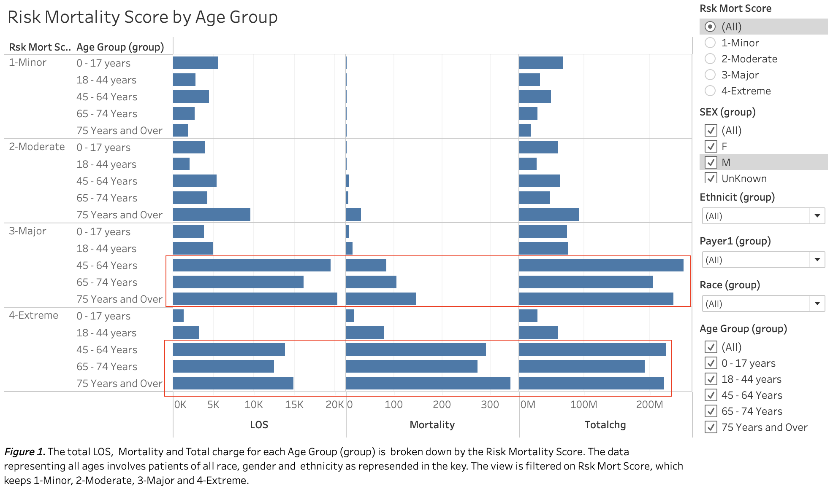
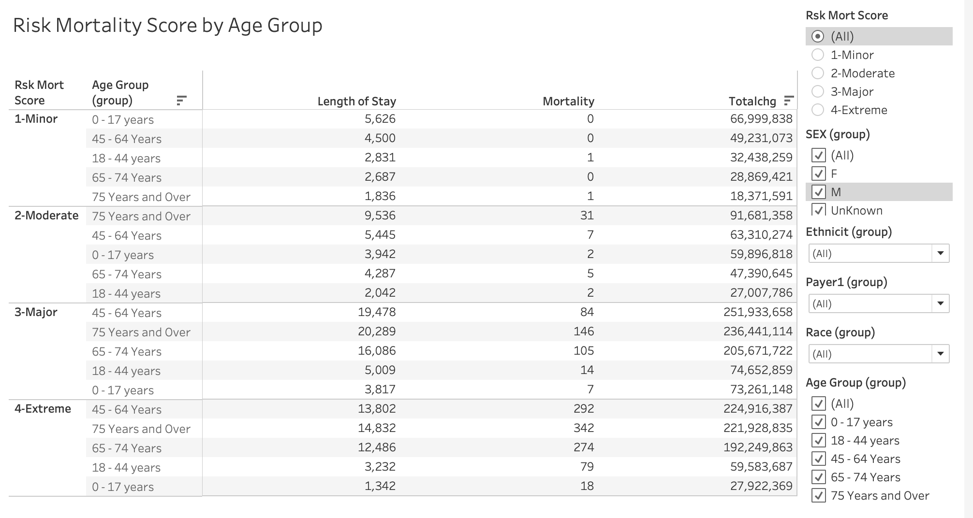
Results
Figure 1. Results showing Length of Stay, Mortality and Total Charge among patients of 0-75+ age groups
The mortality scores of major and extreme had an increase in length of stay among the age group of 45-75+. The age group 45-64 had a mortality of 84 in 3-major and 292 in extreme, age 65-74 had mortality of 105 in major and 274 in extreme and lastly, 75 and over had mortality of 146 in major and 342 in extreme. In addition to this, data mortality of 105 in major and 274 in extreme and lastly, 75 and over had mortality of 146 in major and 342 in extreme mortality scores.
Figure 2. The data shown in the table represents that of figure 1. in the form of bar graphs. It emphasizes the data in a numerical format that expresses how high total charge of respiratory illnesses are, as well of length of stay among each age group.
Within the risk mortality scores of minor and moderate, the ages between 0-65 have the least length of stay and mortality compared to 75 and over. The age group of 75 and over had a mortality of 31 while the age group below 75 is between 0 and 7.

Slide 15
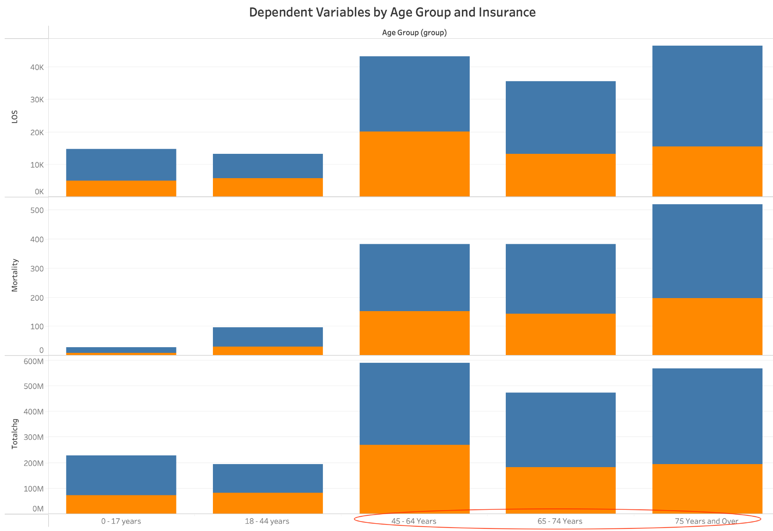
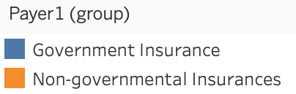
Results (cont.)
Figure 3. The figure above represents the data of age group and insurance with dependent variables of total charge, mortality and length of stay. The insurance group was divided into non-governmental insurances (orange) and governmental insurances(blue) as shown in the key. In all 3 dependent variables,age 45-75+ had the highest rates relative to the both insurances but higher in government insurances than non-governmental insurances.The total charges of 45-75+ were all over 400M and mortality over 300.

Slide 16
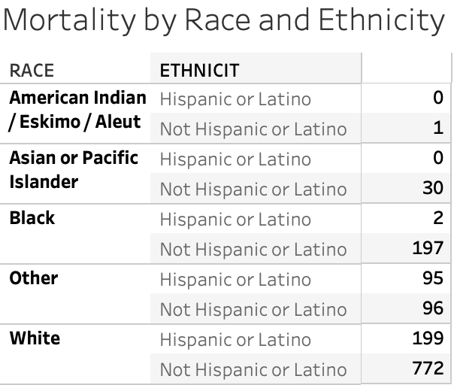
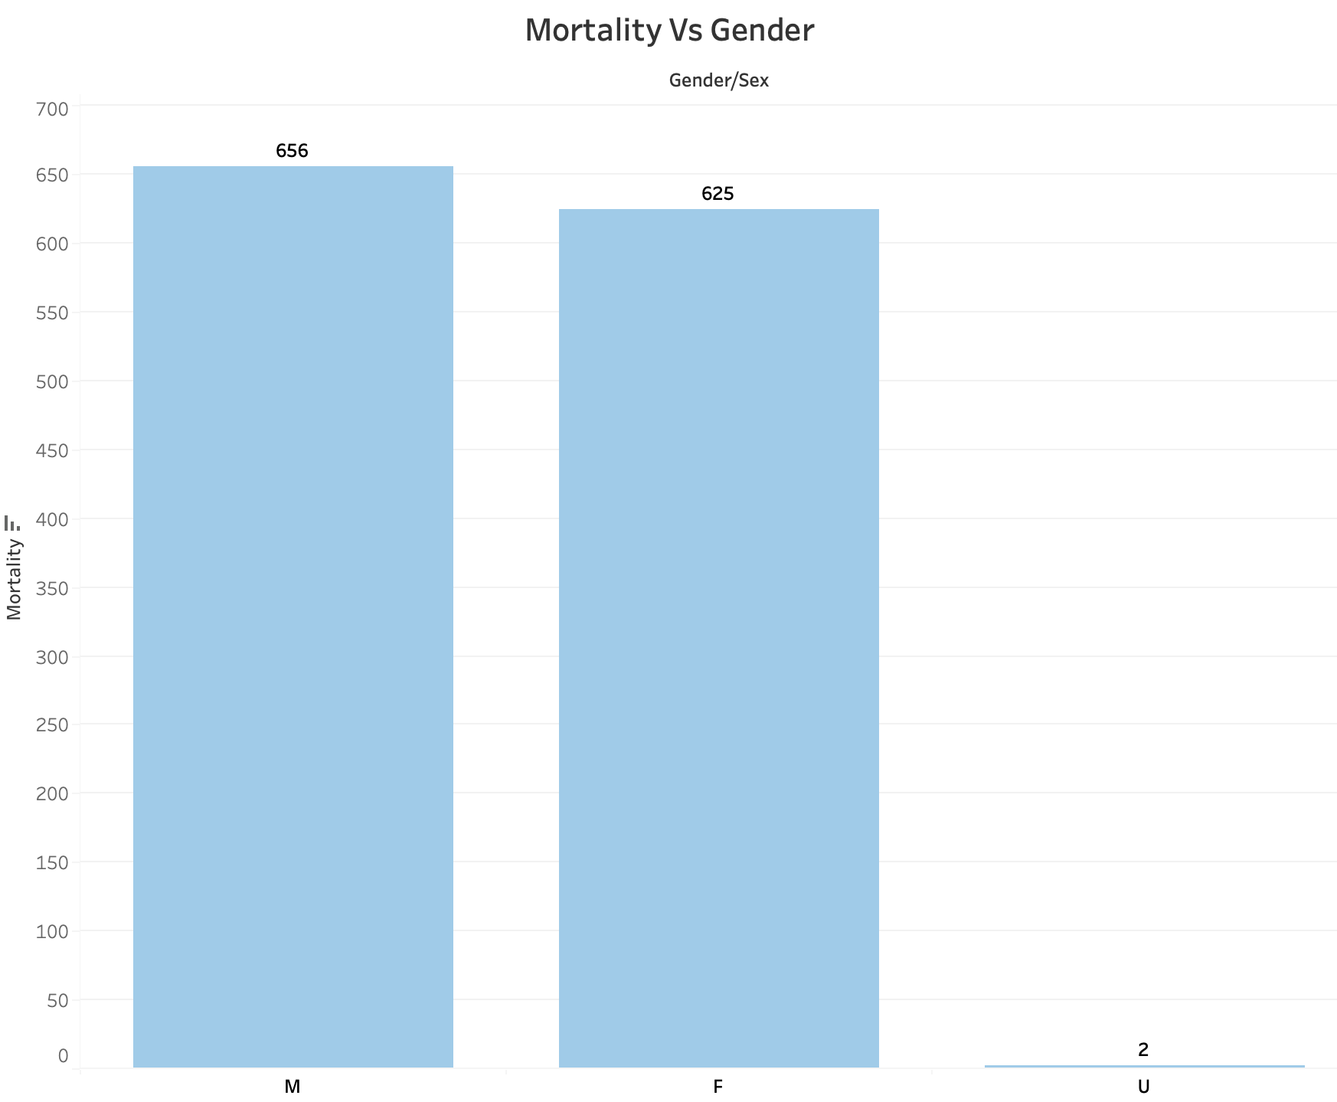
Results
Figure 4. The results show the mortality by race / ethnicity of respiratory illnesses in the state of Texas. The ethnicity of hispanic or latino is also shown, relative to the race of each patient shown in the data table.
Figure 5. The graph expresses the mortality rate of respiratory illnesses by gender in the state of Texas. The results show 656 death for males and 625 for females with 2 for unspecified.

Slide 17
Discussion
Results and correlation with research
Strength of respiratory muscles decreases with age leading to higher susceptibility to lung disease/malfunction (NIH National Library)
Data set taken from 2020, during rise of COVID-19 which exacerbated respiratory problems across the population
Pneumonia was the most common respiratory illness
Insufficient information to make any conclusions about the link between Race, Gender and Mortality, due to data set being primarily of one Race group (white)
Risk Mortality Score Vs Age Group
Increase in Risk Mortality Score to Major and Extreme levels has especially dramatic effect on Mortality, particularly among 75+ age population
Younger age groups from 0 to 40 years have lowest Mortality rates in the Minor and Moderate Risk Mortality scores
Mortality relative to age supports our aim to bring awareness of factors that better chances for survival of respiratory illness, and encourage changes in lifestyle choices to accomplish this
Total charge, mortality and length of stay by Age group and Insurance
Governmental insurance shows increase in all of these dependent variables than non-governmental insurance
Ages of 45-75+ had highest number of Total Charges, Length of Stay, and Mortality
Age groups below 45 did not show correlation with Mortality
Total Charge of Cost of respiratory illnesses was very high, despite Mortality rates or Length of Stay

Slide 18
Discussion (Cont)
Overall, the total charges for respiratory illnesses were in the millions for all ages but mostly older patients, and revealed higher mortality rates on governmental insurances than non-governmental. With the provided data on age and insurance, it bring awareness to the disparities and factors, that could trigger higher risks of mortality of respiratory illnesses. The results could help to eliminate these barriers such as cost, and improve quality care of patients not just in Texas but the whole country.
Limitations
Data source for our study was limited to just one state, Texas
Specific cause(s) of each respiratory illness were unknown
Limited access to more complete data
Insufficient information to correlate Race or Gender with some dependent variables

Slide 19
Policy Recommendations
During the months of October to April ( ILI season), wear masks and avoid crowds
More stringent regulations and site visits should be implemented in government hospitals

Slide 20
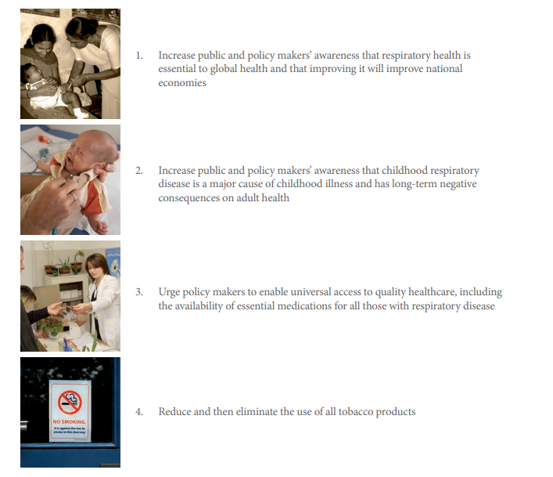
Policy Recommendations

Slide 21
References
1) “ College Admissions Testing: SAT and ACT.” Completion, Graduation, and Dropouts, 29 Aug. 2017,
tea.texas.gov/acctres/sat_act_index.html.8)
2) Kindig D, Stoddart G. What Is Population Health? American Journal of Public Health. 2003;93(3):380-383.
3) “National Center for Health Statistics.” Centers for Disease Control and Prevention, Centers for Disease Control and
Prevention, 21 Dec. 2017, www.cdc.gov/nchs/products/databriefs/db293.htm.
4) “National Health Accounts Historical.” Centers for Medicare & Medicaid Services, 8 Jan. 2018, www.cms.gov
5)Respiratory Diseases in the World: Realities of Today – Opportunities for Tomorrow’, Forum of International Respiratory
Societies (FIRS). http://www.thoracic.org/global-health/firs-report-respiratory-diseases-in-the-world/index.php.
6) Rojas, Mauricio, et al. “Aging and Lung Disease. Clinical Impact and Cellular and Molecular Pathways.” Annals of the
American Thoracic Society, U.S. National Library of Medicine, Dec. 2015,
https://www.ncbi.nlm.nih.gov/pmc/articles/PMC6137674/.
7) Rutledge SA, Masalovich S, Blacher RJ, Saunders MM. Diabetes Self-Management Education Programs in Nonmetropolitan
Counties - United States, 2016. MMWR Surveill Summ 2017;66(No. SS-10):1–6. DOI:
http://dx.doi.org/10.15585/mmwr.ss6610a1
8) Salgaonkar, Sheetal. "TRENDS IN RESPIRATORY DISEASES." Rgare.com

Slide 22
References (cont.)
9) “Social Determinants of Health.” Heart Disease and Stroke | Healthy People 2020,
www.healthypeople.gov/2020/topics-objectives/topic/social-determinants-of-health.
10) “Social Determinants of Health: Know What Affects Health.” Centers for Disease Control and Prevention, Centers for
Disease Control and Prevention, 29 Jan. 2018, www.cdc.gov/socialdeterminants/.
11)“The Social Determinants of Health: Coming of Age” Paula Braveman, Susan Egerter, David R. Williams. Annual
Review of Public Health. 2011 32:1, 381-398
12) Ventres, W., Dharamsi, S., & Ferrer, R. (2016). From social determinants to social interdependency: Theory,
reflection, and engagement. Social Medicine, 11(2), 84–89.

Slide 23
Acknowledgements
Group 4 would like to express special thanks and appreciation to :
Dr. De Melo, Dr. Hadi, organizers and contributors of Bowie State University
Dr. Kmir, Dr. Harvey, Dr. Kharrazi, Dr. Matthews, Dr. Mareboyana, Ms. Halima, Dr. Omar and Dr. Mangla for their lectures and guidance to educate the students in all aspects of the PHIT Bootcamp.
The organizations and Biden Administration for making this bootcamp possible, while improving diversity and knowledge to address the increasing demands for Public Health Informatics professionals.
Notes:
Done — 11/16/22: this needs to be revised; acknowledgements slide should not be referencing the group members (it makes little sense to congratulate ourselves on a project’s completion — instead it should point out the efforts and guidance of professors and organizations that made the work possible (Dr. De Melo, Dr. Hadi, Bowie State University, etc), -Yousaf

